Slide 1
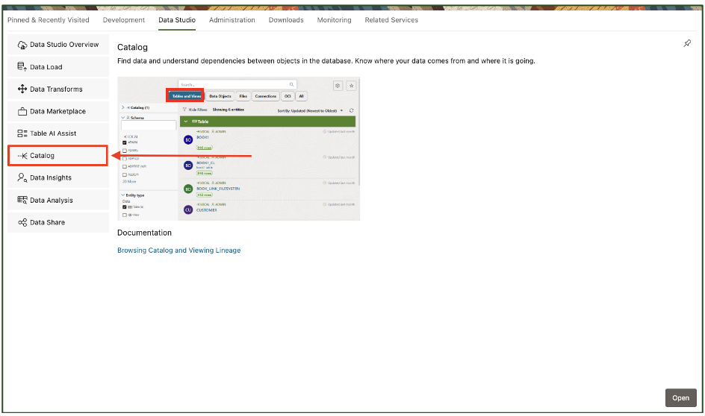

Slide 2
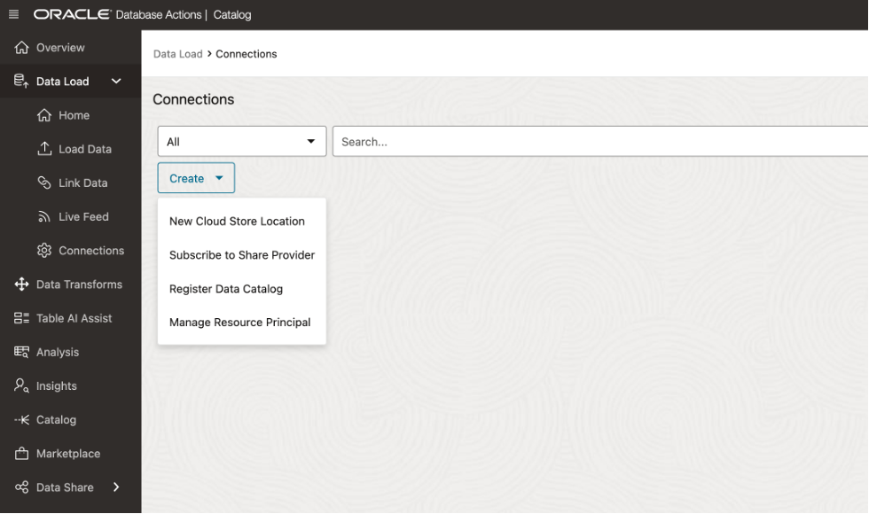

Slide 3
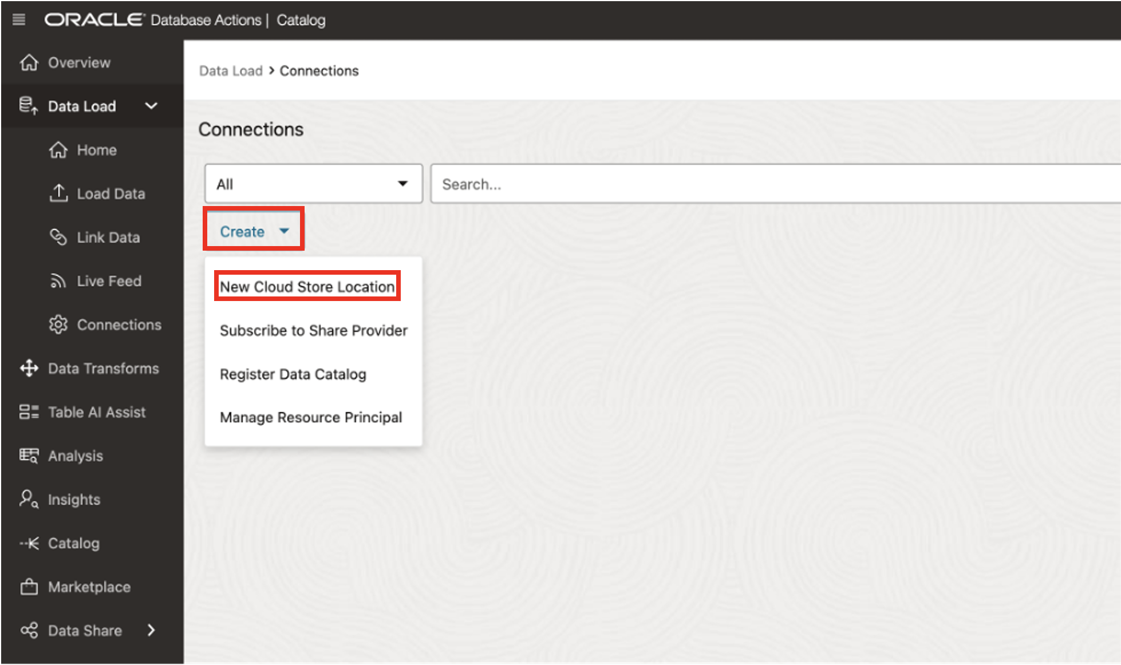

Slide 5
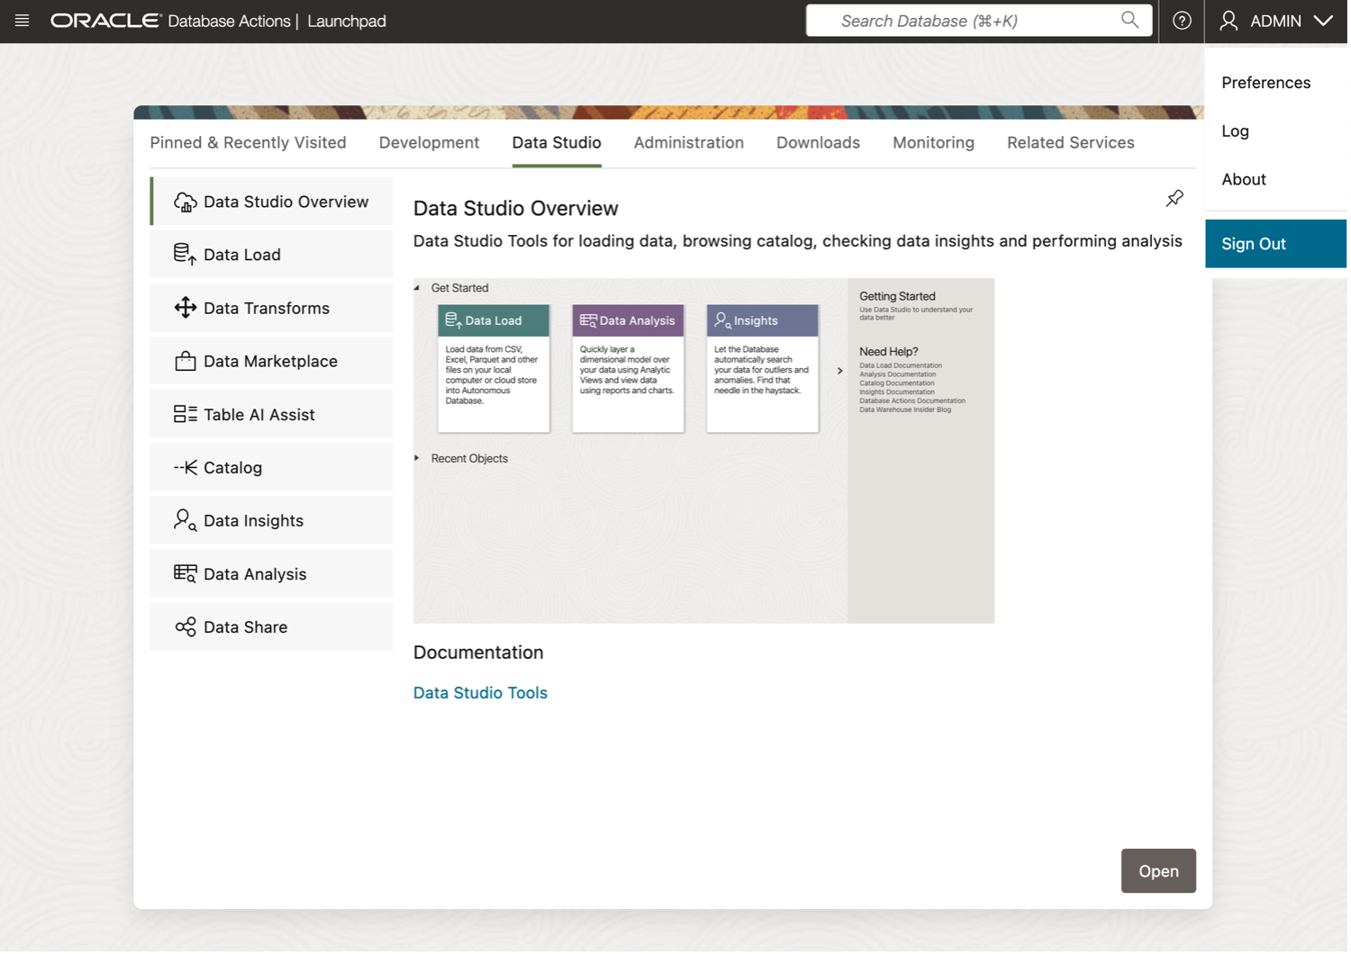
Lab 3: Discover and View your Data Lake Assets from your Data Catalog
access-local-data-catalog-1

Slide 6
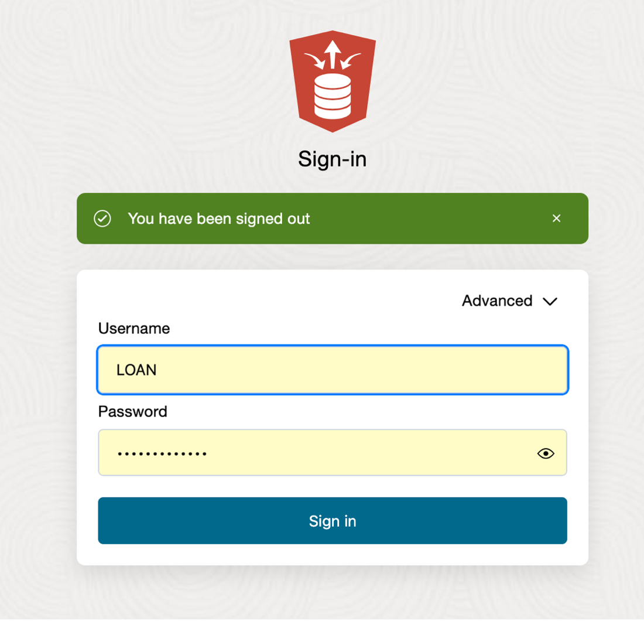
Lab 3: Discover and View your Data Lake Assets from your Data Catalog
access-local-data-catalog-2

Slide 7
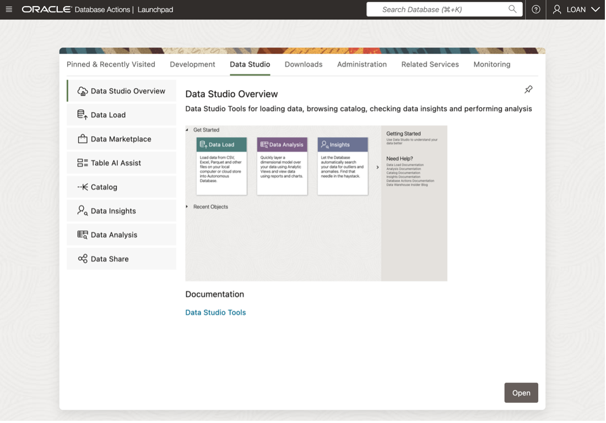
Lab 3: Discover and View your Data Lake Assets from your Data Catalog
access-local-data-catalog-3.png

Slide 8
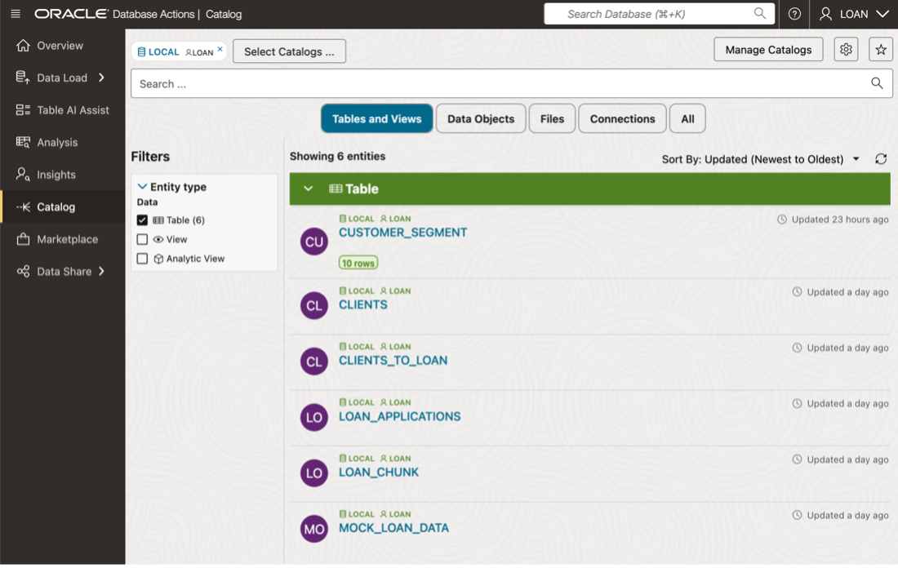
Lab 3: Discover and View your Data Lake Assets from your Data Catalog
access-local-data-catalog-4.png

Slide 9
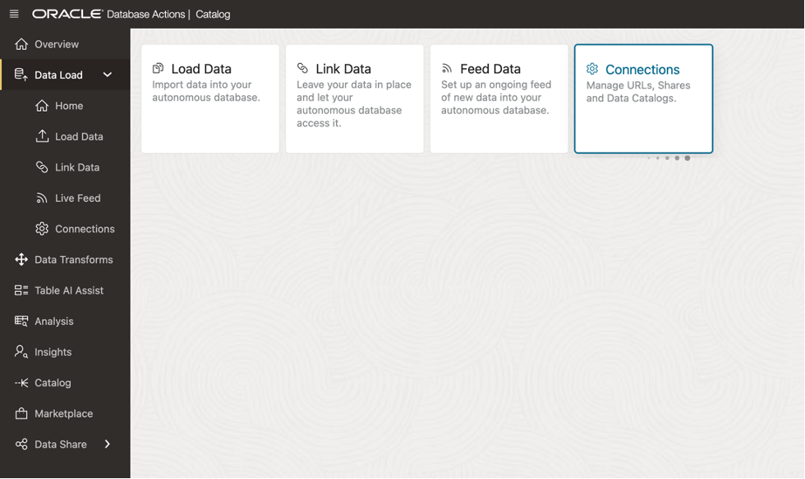
Lab 3: Discover and View your Data Lake Assets from your Data Catalog
add-connections-to-catalog-1.png

Slide 10
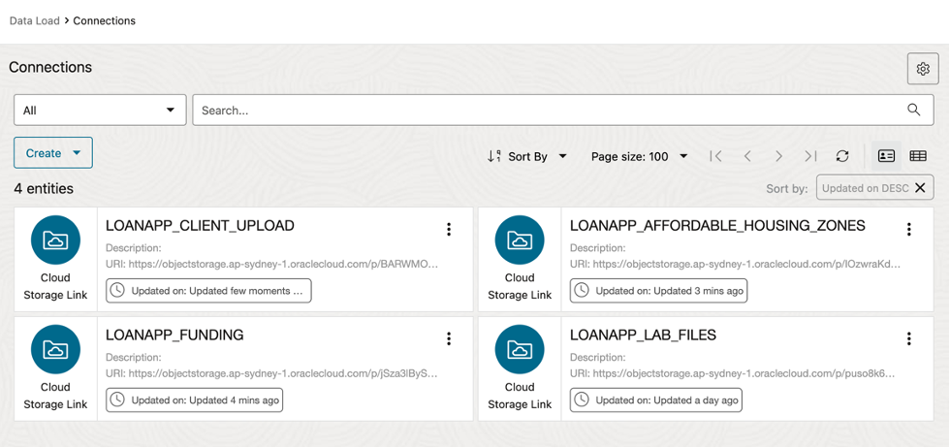
Lab 3: Discover and View your Data Lake Assets from your Data Catalog
add-connections-to-catalog-2.png

Slide 11
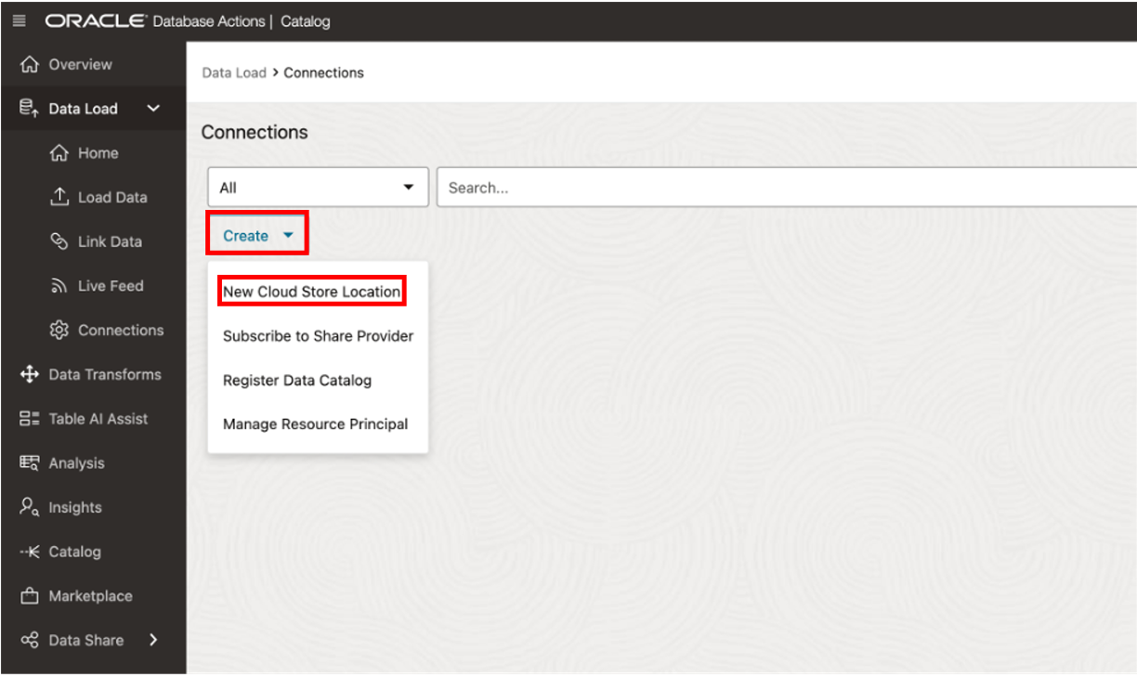
Lab 3: Discover and View your Data Lake Assets from your Data Catalog
add-connections-to-catalog-3.png

Slide 12
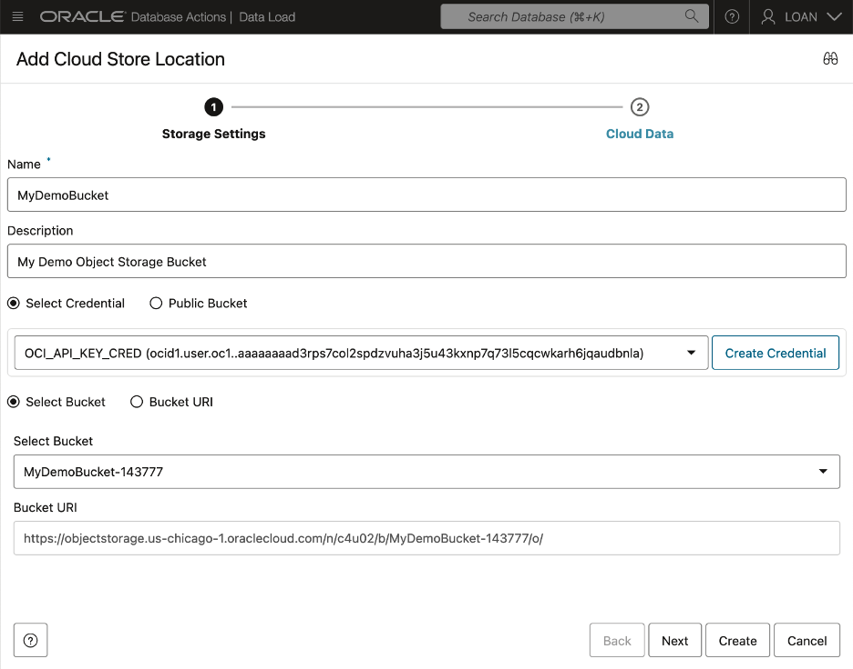
Lab 3: Discover and View your Data Lake Assets from your Data Catalog
add-connections-to-catalog-4-w-select-bucket.png

Slide 13
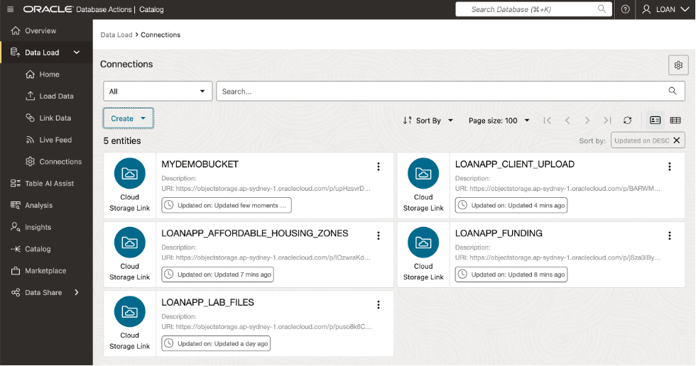
Lab 3: Discover and View your Data Lake Assets from your Data Catalog
add-connections-to-catalog-5.png

Slide 14
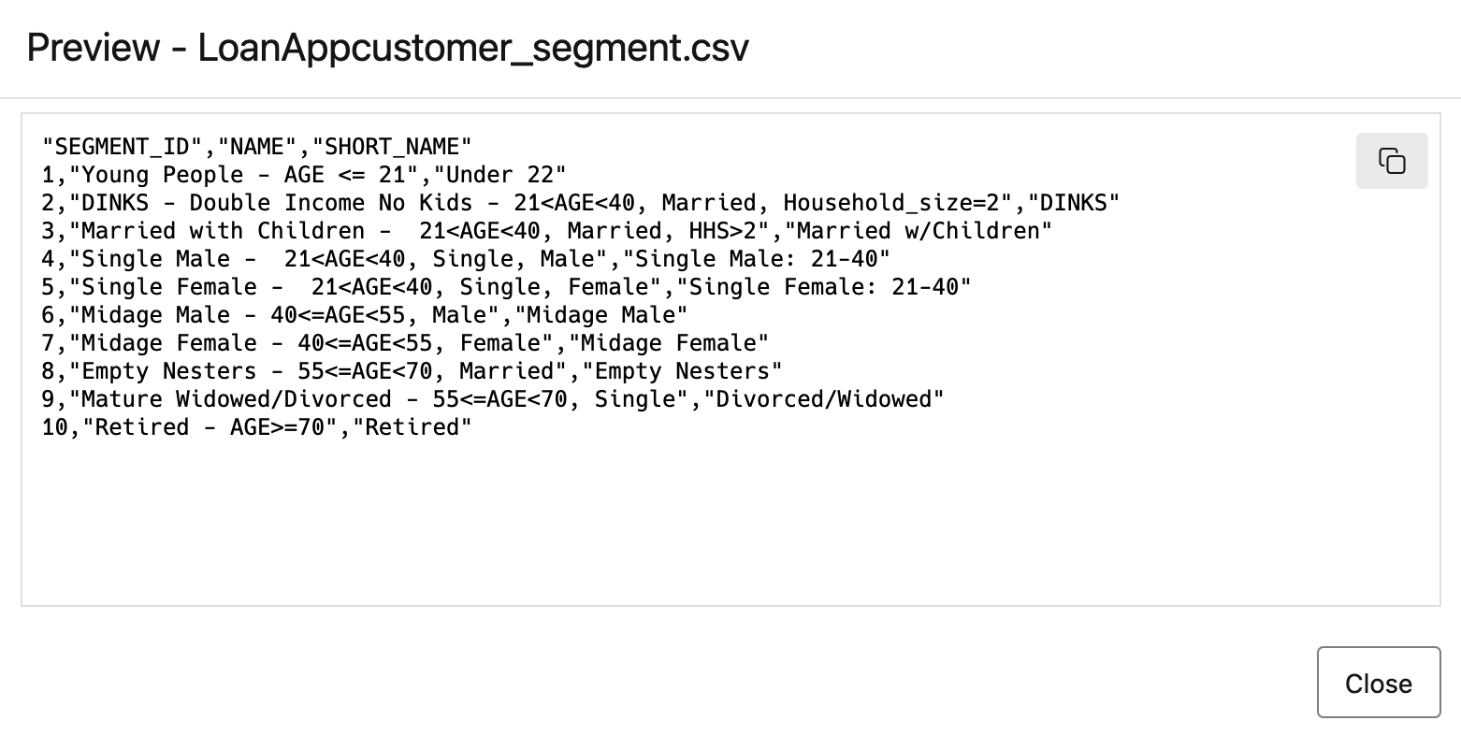
Lab 3: Discover and View your Data Lake Assets from your Data Catalog
data-catalog-csv-preview.png

Slide 15
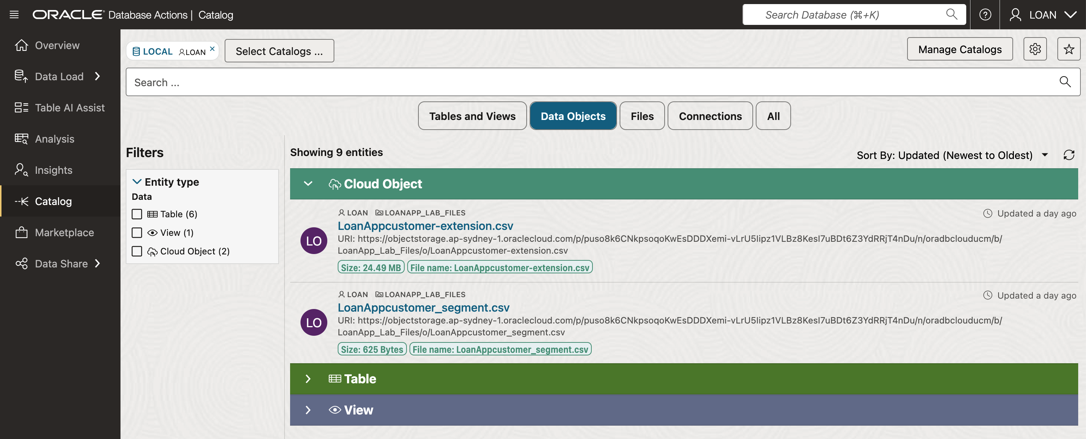
Lab 3: Discover and View your Data Lake Assets from your Data Catalog
data-catalog-data-objects.png

Slide 16
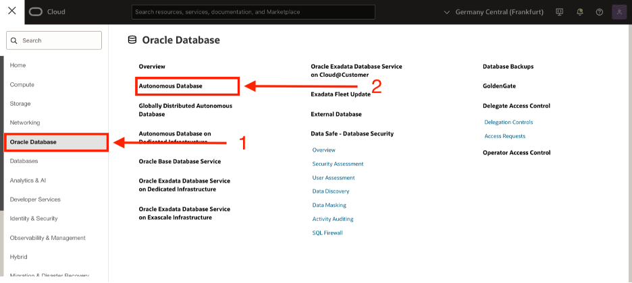
Lab 3: Discover and View your Data Lake Assets from your Data Catalog
navigate-to-adb.png

Slide 17
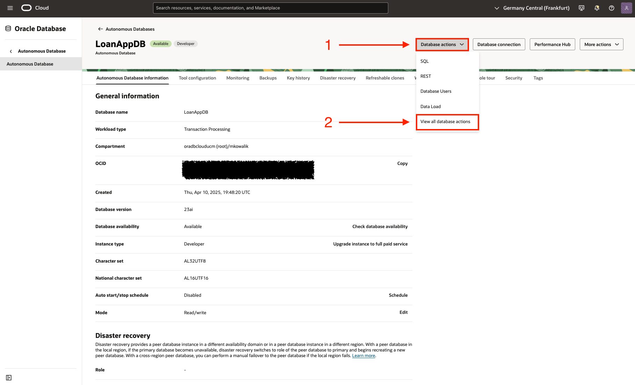
Lab 3: Discover and View your Data Lake Assets from your Data Catalog
oci-adb-database-actions.png

Slide 18
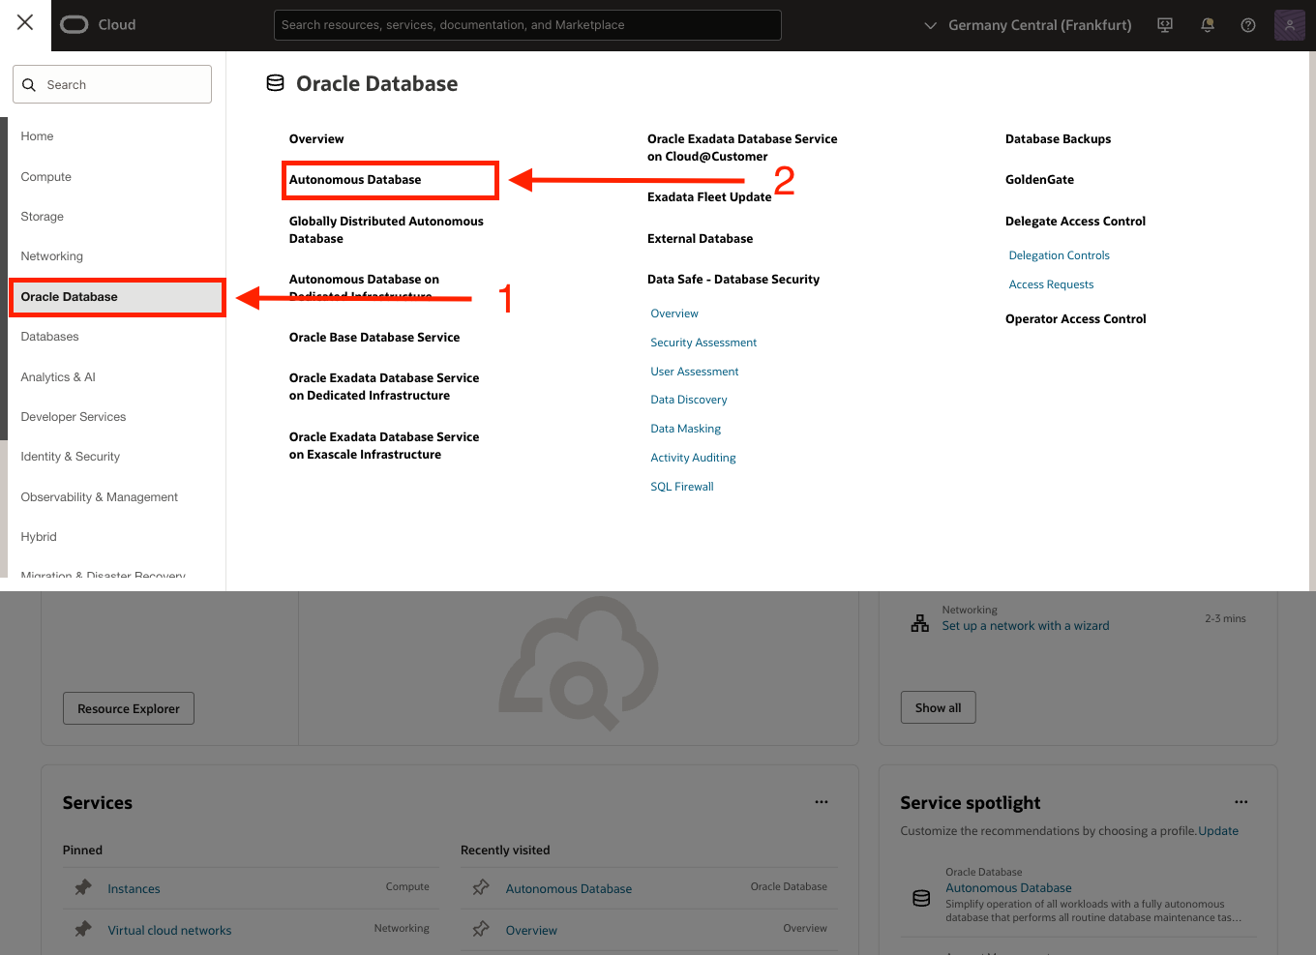
Lab 3: Discover and View your Data Lake Assets from your Data Catalog
oci-adb.png

Slide 19
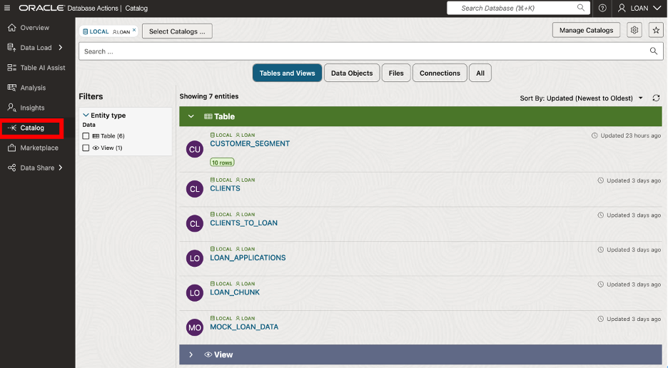
Lab 3: Discover and View your Data Lake Assets from your Data Catalog
search-items-in-catalog-1.png

Slide 20
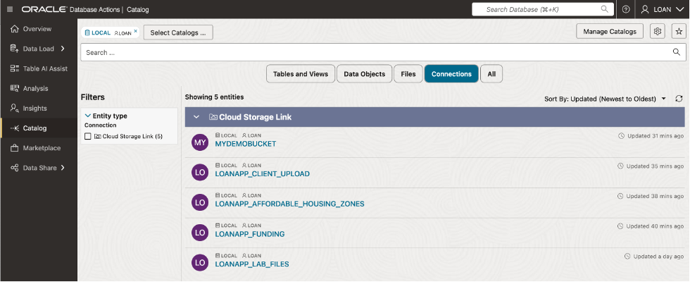
Lab 3: Discover and View your Data Lake Assets from your Data Catalog
search-items-in-catalog-2.png

Slide 22
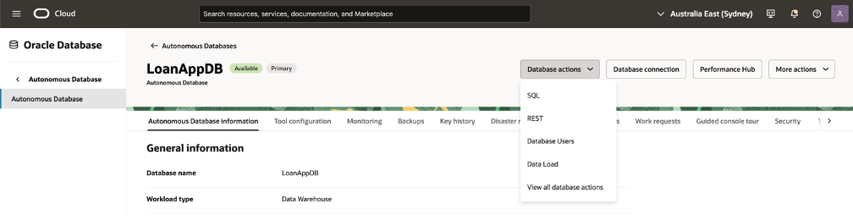
Lab 4: Load, Link and Query Object Storage Data from Autonomous Database
task1-scrn-3.png

Slide 23
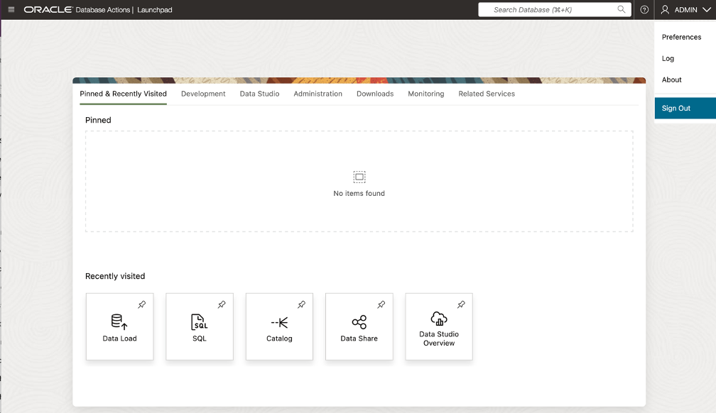
Lab 4: Load, Link and Query Object Storage Data from Autonomous Database
task1-scrn-4.png

Slide 24
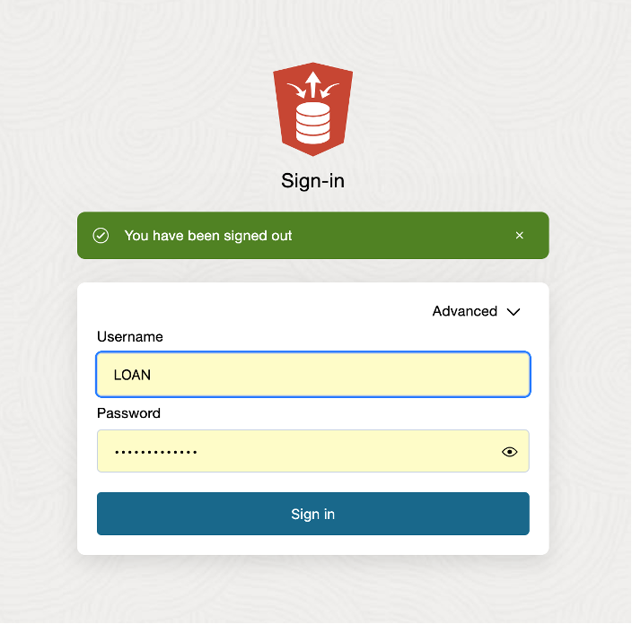
Lab 4: Load, Link and Query Object Storage Data from Autonomous Database
task1-scrn-5.png

Slide 25
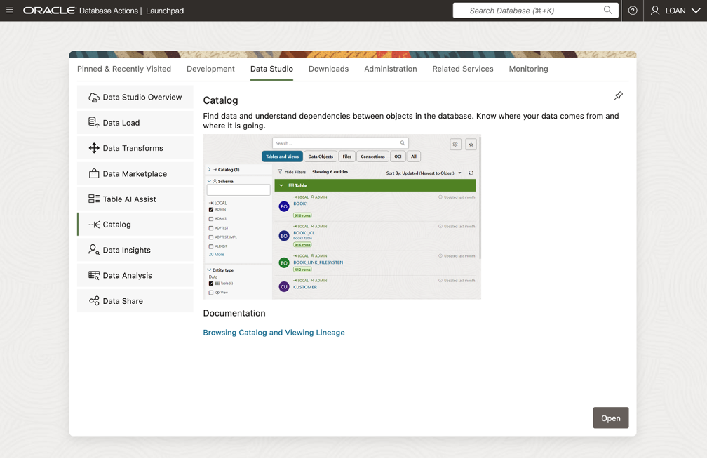
Lab 4: Load, Link and Query Object Storage Data from Autonomous Database
task1-scrn-7.png

Slide 26
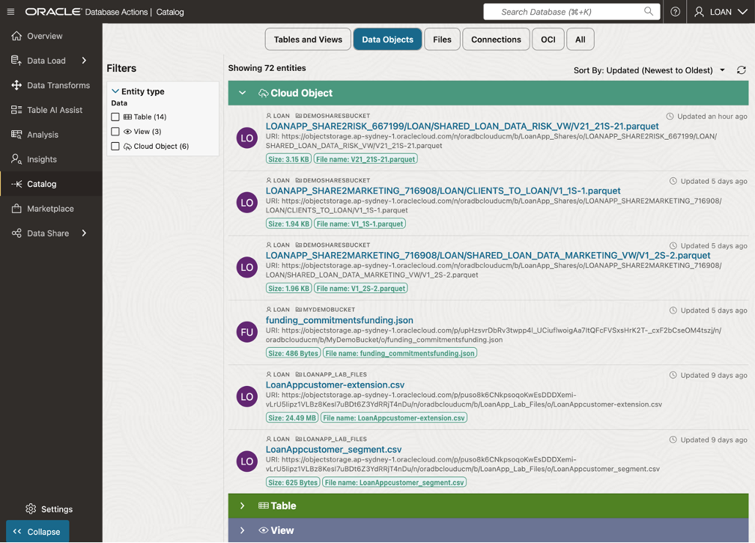
Lab 4: Load, Link and Query Object Storage Data from Autonomous Database
task1-scrn-8.png

Slide 27
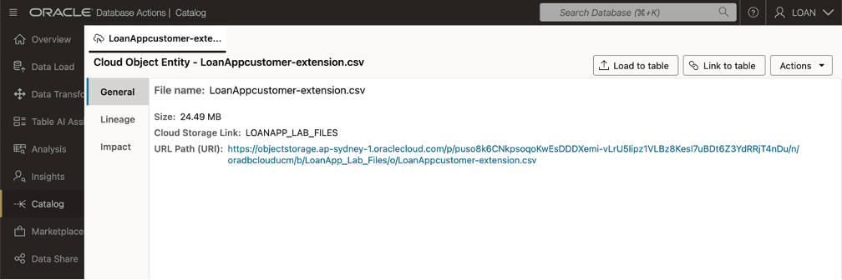
Lab 4: Load, Link and Query Object Storage Data from Autonomous Database
task1-scrn-9.png

Slide 28
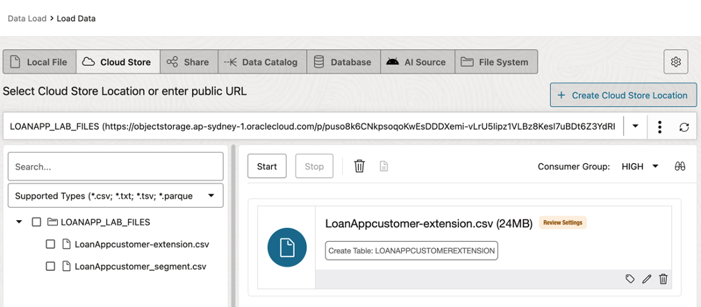
Lab 4: Load, Link and Query Object Storage Data from Autonomous Database
task1-scrn-10.png

Slide 29
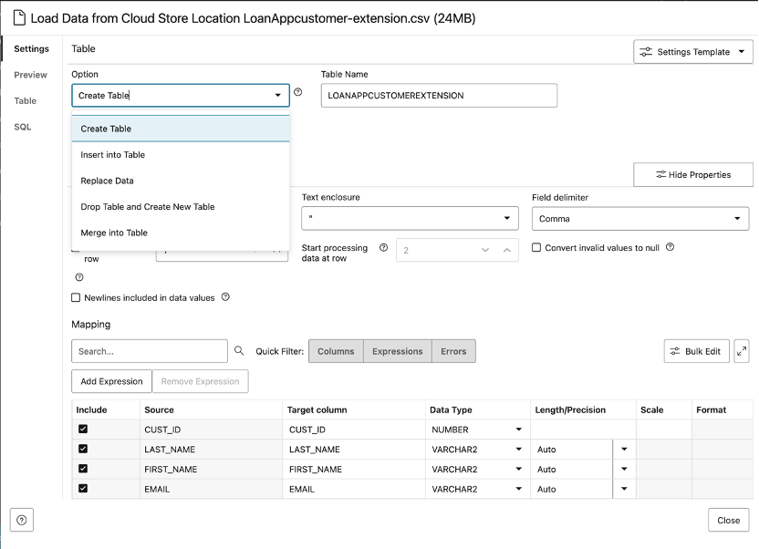
Lab 4: Load, Link and Query Object Storage Data from Autonomous Database
task1-scrn-11.png

Slide 30
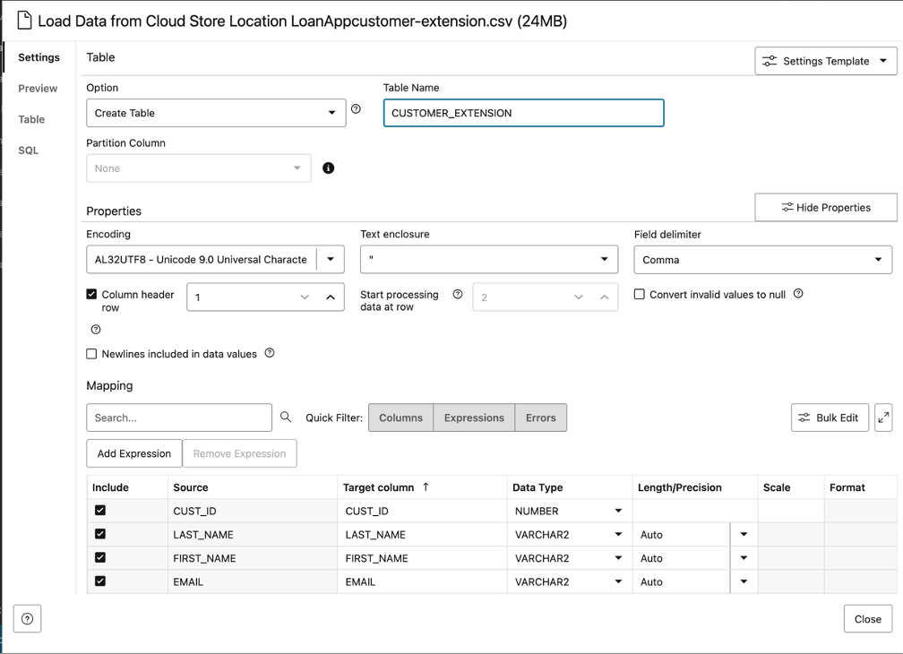
Lab 4: Load, Link and Query Object Storage Data from Autonomous Database
task1-scrn-12.png

Slide 31
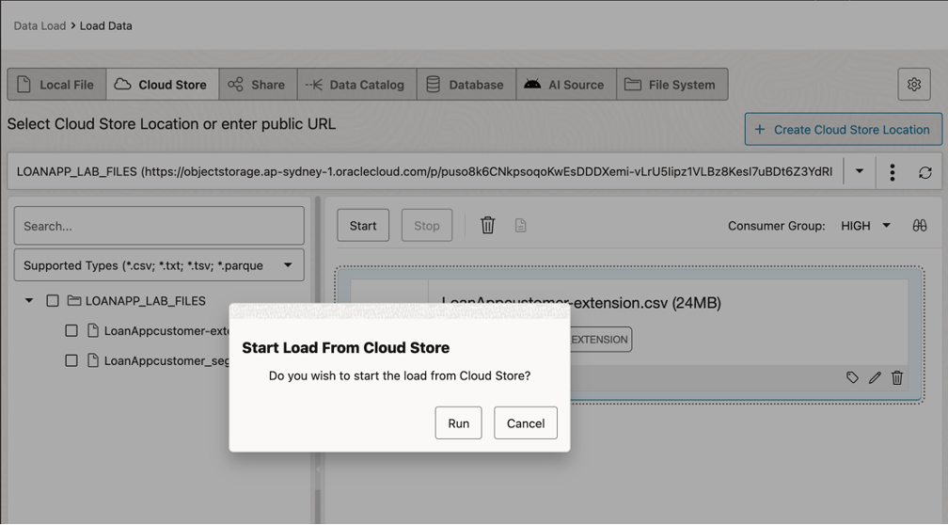
Lab 4: Load, Link and Query Object Storage Data from Autonomous Database
task1-scrn-13.png

Slide 32
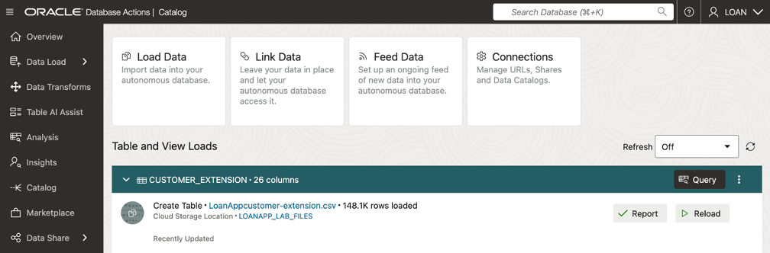
Lab 4: Load, Link and Query Object Storage Data from Autonomous Database
task1-scrn-14.png

Slide 33
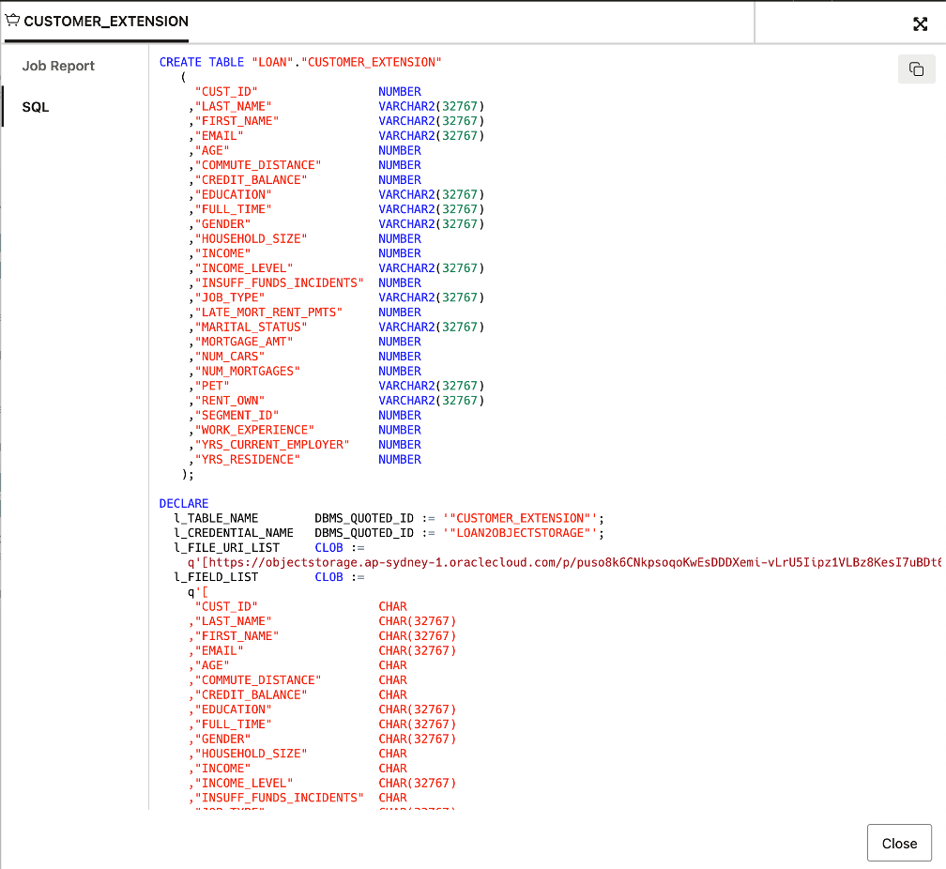
Lab 4: Load, Link and Query Object Storage Data from Autonomous Database
task1-scrn-15.png

Slide 34
Lab 4: Load, Link and Query Object Storage Data from Autonomous Database
task1-scrn-16.png

Slide 35
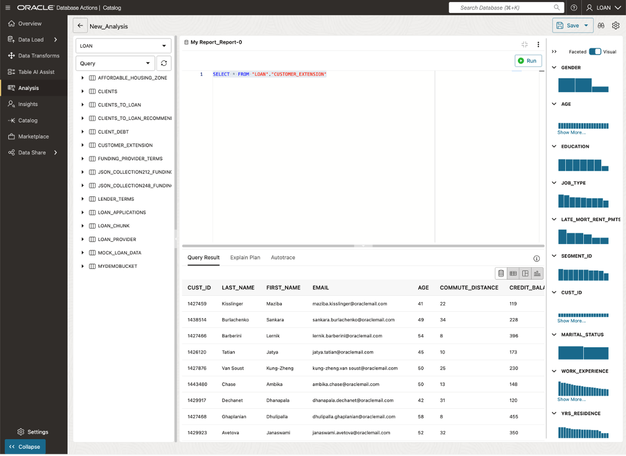
Lab 4: Load, Link and Query Object Storage Data from Autonomous Database
task1-scrn-16.png

Slide 36
Lab 4: Load, Link and Query Object Storage Data from Autonomous Database
task1-scrn-17.png

Slide 37
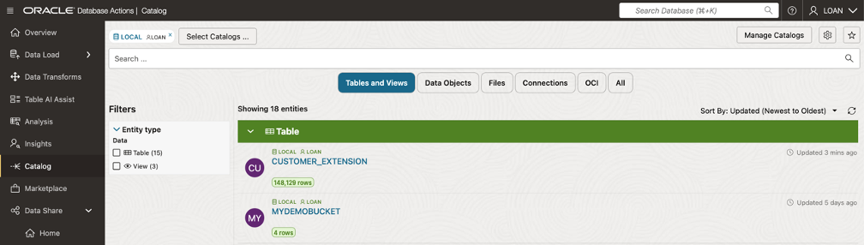
Lab 4: Load, Link and Query Object Storage Data from Autonomous Database
task1-scrn-18.png

Slide 38
Lab 4: Load, Link and Query Object Storage Data from Autonomous Database
task1-scrn-18.png

Slide 39
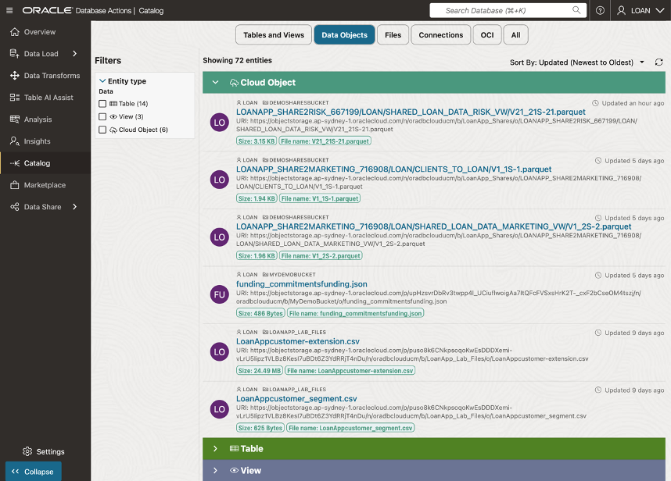
Lab 4: Load, Link and Query Object Storage Data from Autonomous Database
task2-scrn-1a.png

Slide 40
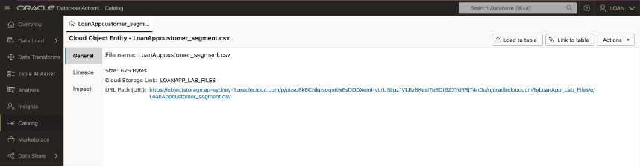
Lab 4: Load, Link and Query Object Storage Data from Autonomous Database
task2-scrn-10a.png

Slide 41
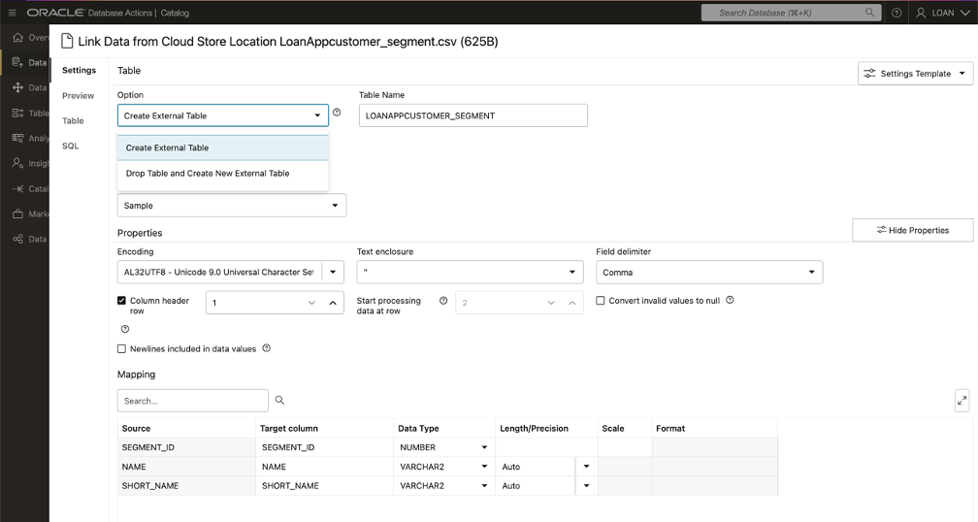
Lab 4: Load, Link and Query Object Storage Data from Autonomous Database
task2-scrn-11.png

Slide 42
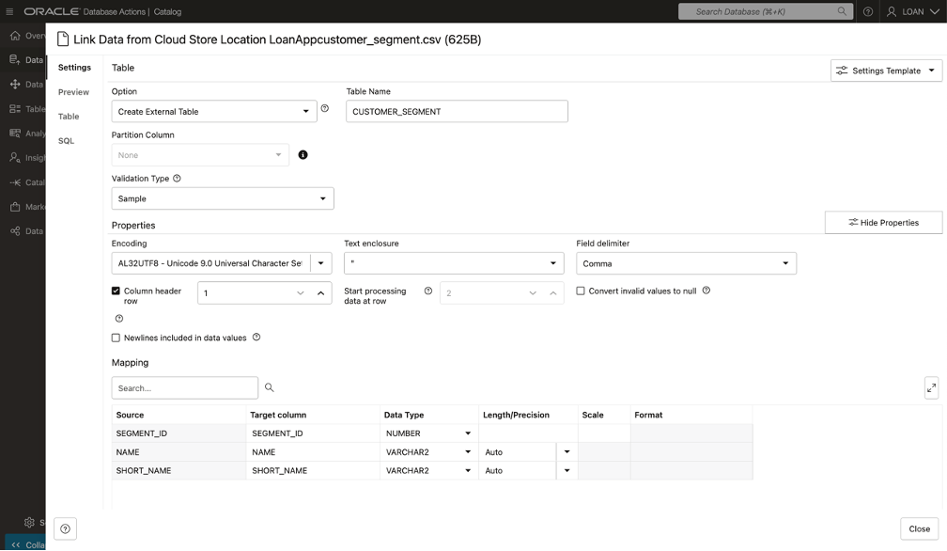
Lab 4: Load, Link and Query Object Storage Data from Autonomous Database
task2-scrn-12.png

Slide 43
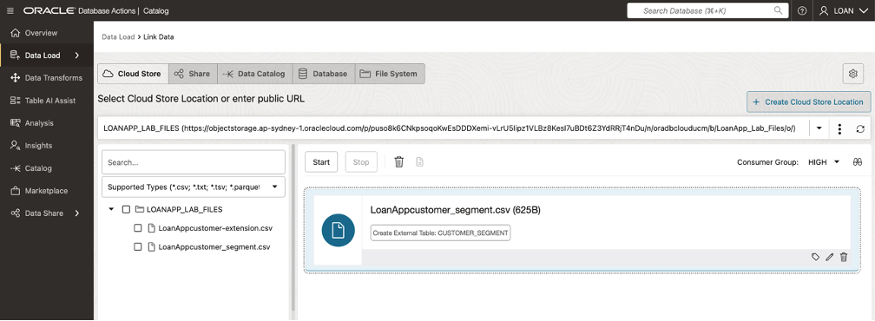
Lab 4: Load, Link and Query Object Storage Data from Autonomous Database
task2-scrn-12a.png

Slide 44
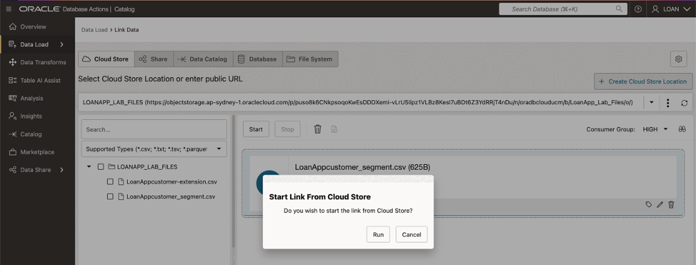
Lab 4: Load, Link and Query Object Storage Data from Autonomous Database
task2-scrn-13.png

Slide 45
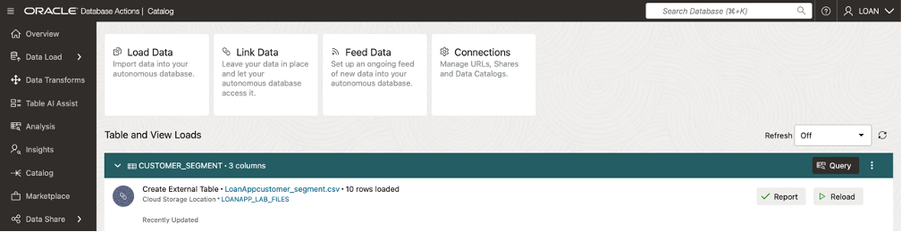
Lab 4: Load, Link and Query Object Storage Data from Autonomous Database
task2-scrn-14.png

Slide 46
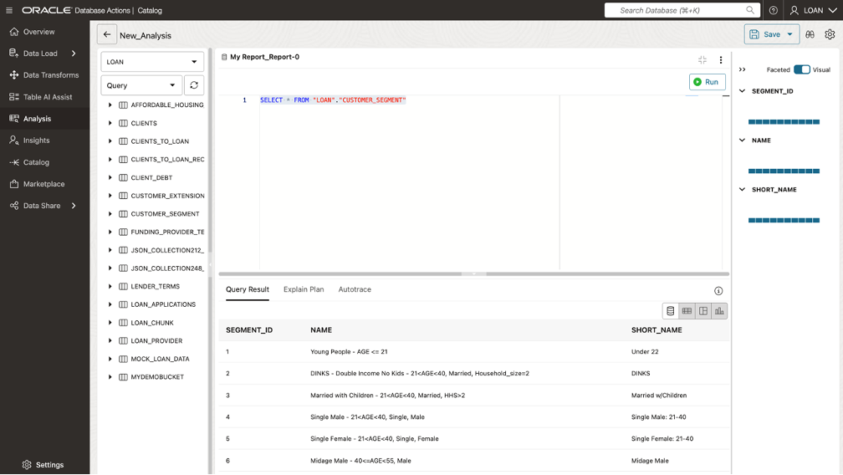
Lab 4: Load, Link and Query Object Storage Data from Autonomous Database
task2-scrn-17.png

Slide 47

Lab 4: Load, Link and Query Object Storage Data from Autonomous Database
task3-scrn-1.png

Slide 48
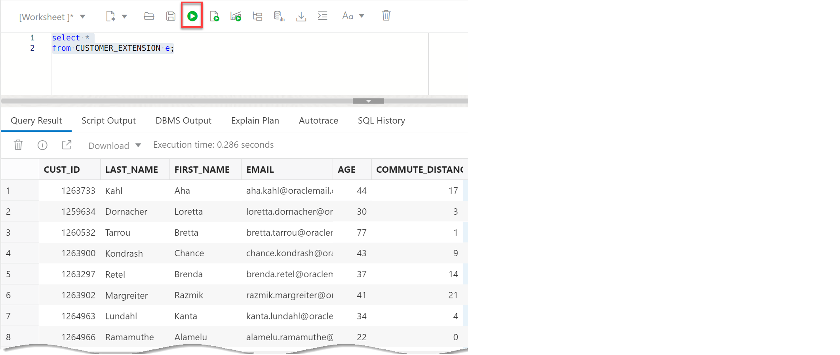
Lab 4: Load, Link and Query Object Storage Data from Autonomous Database
task3-scrn-2.png

Slide 49
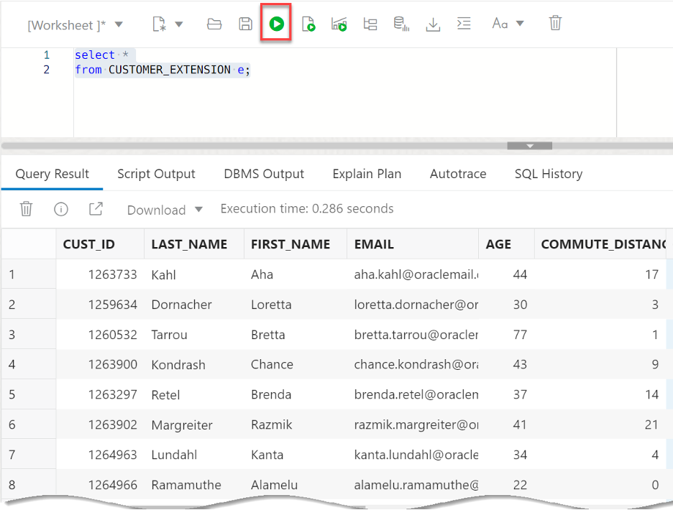
Lab 4: Load, Link and Query Object Storage Data from Autonomous Database
task3-scrn-3.png

Slide 50
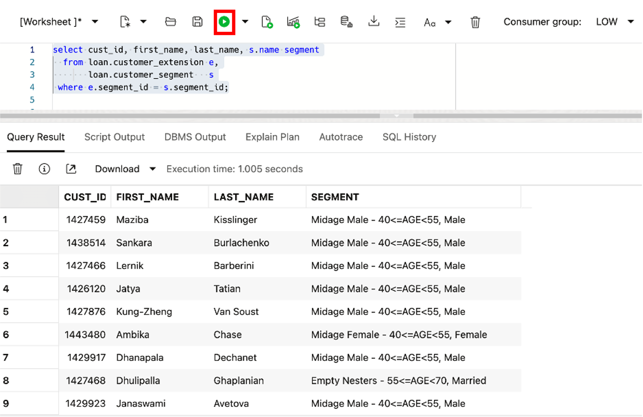
Lab 4: Load, Link and Query Object Storage Data from Autonomous Database
task3-scrn-4a.png

Slide 52
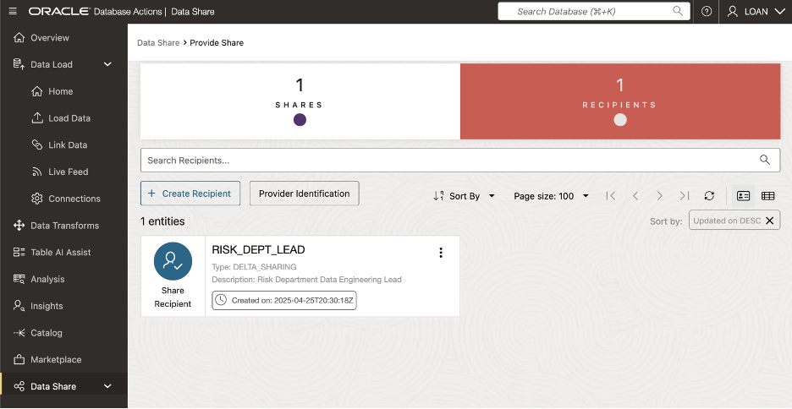
Lab 5: Create & Share Data Products
create-risk-dept-recipient.png

Slide 53
Lab 5: Create & Share Data Products
create-risk-recipient.png

Slide 54
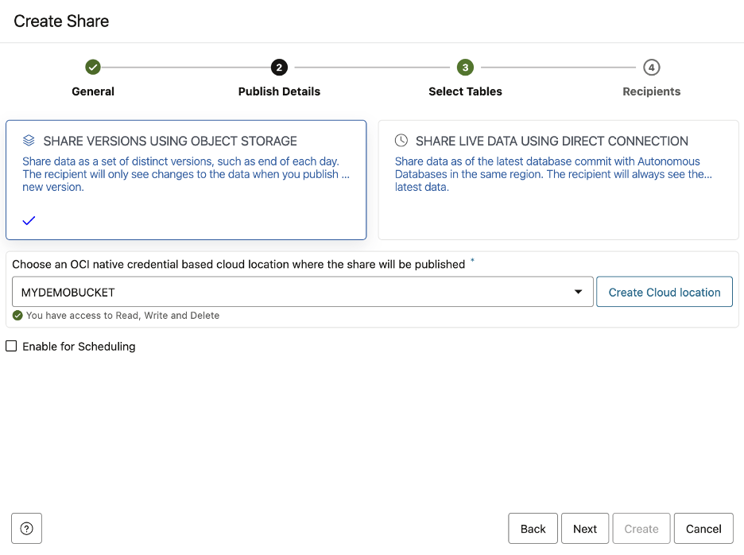
Lab 5: Create & Share Data Products
create-share-bucket.png

Slide 55
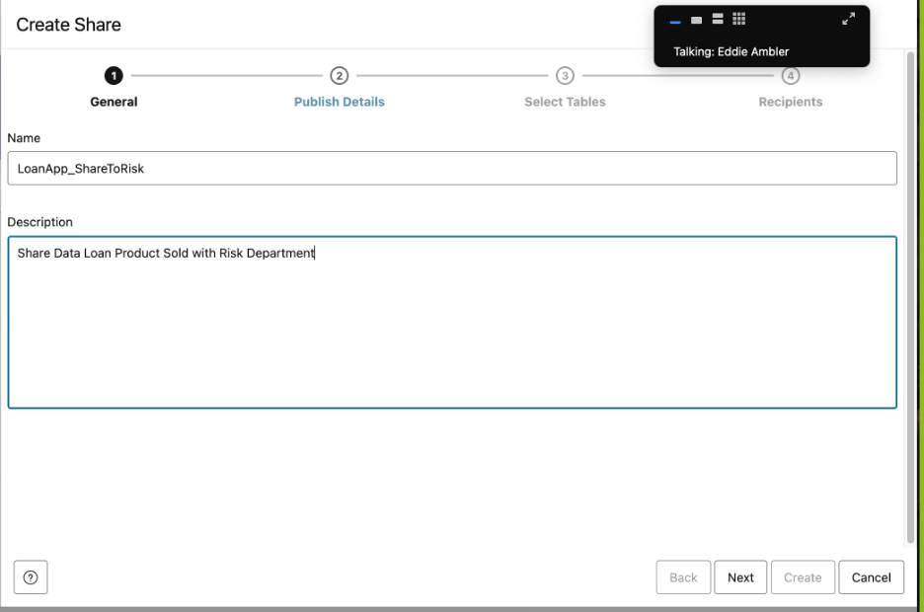
Lab 5: Create & Share Data Products
create-share-general-risk.png

Slide 56
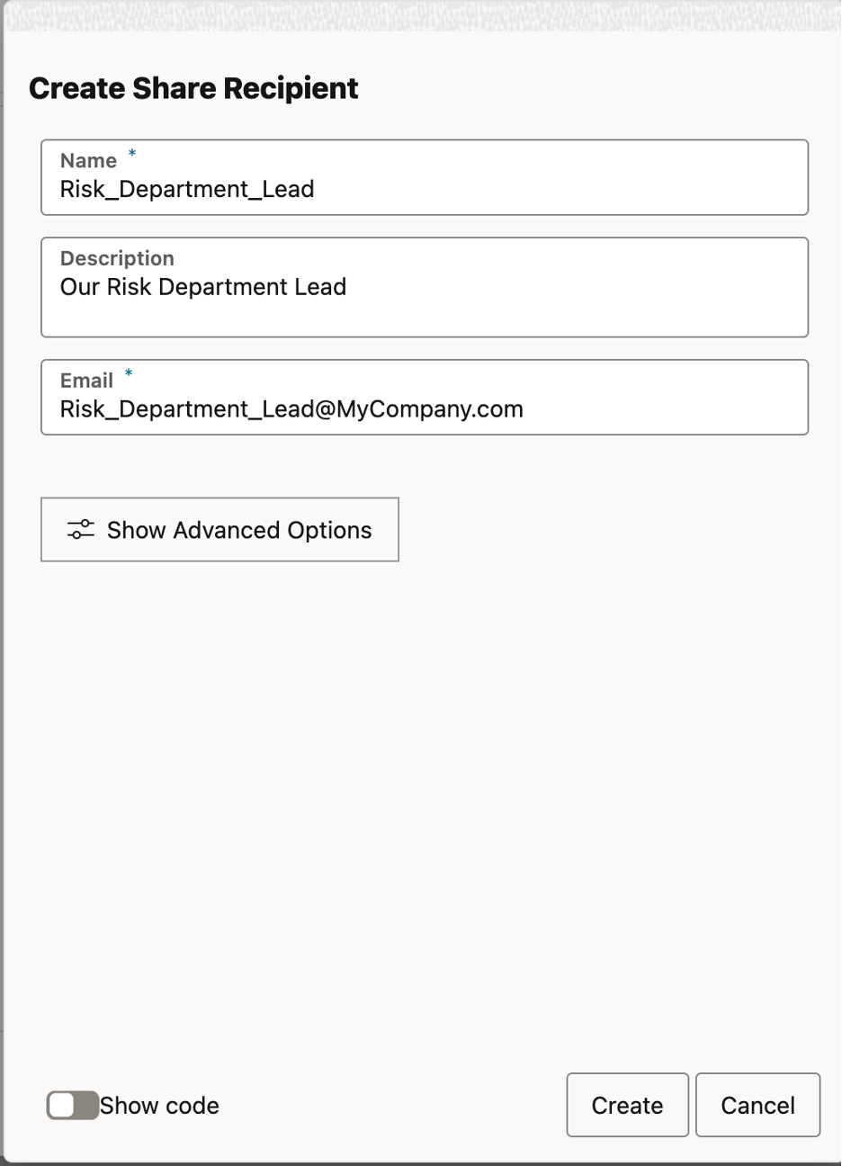
Lab 5: Create & Share Data Products
create-share-recipient-risk.png

Slide 57
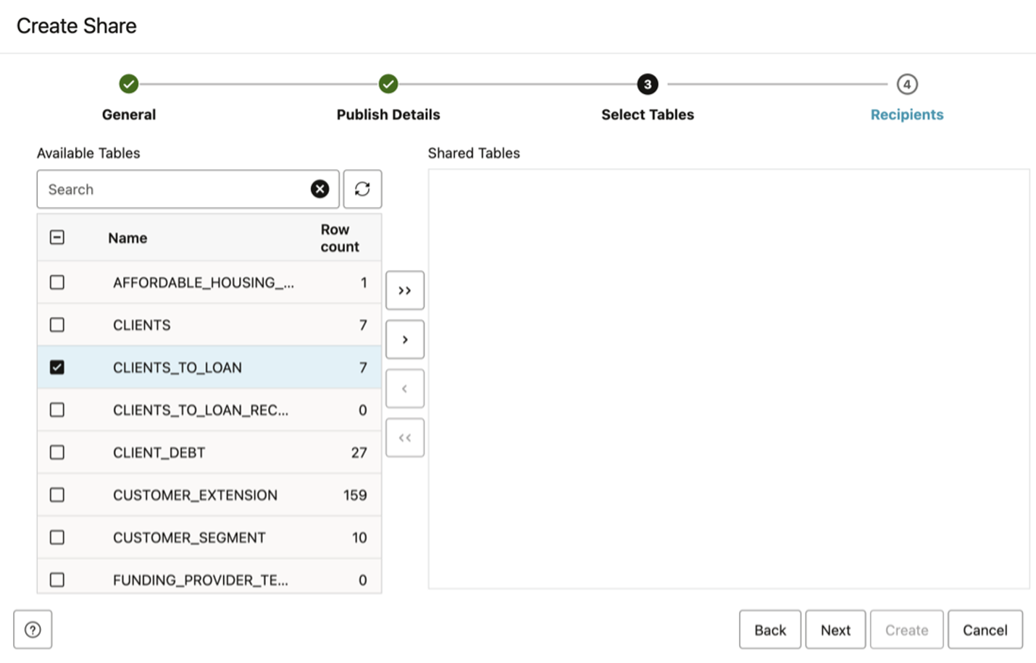
Lab 5: Create & Share Data Products
create-share-select-table-risk.png

Slide 58
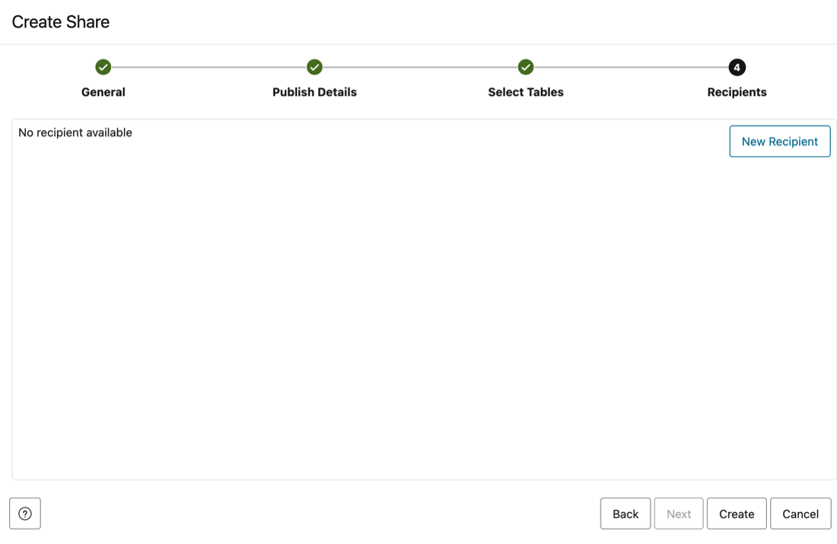
Lab 5: Create & Share Data Products
define-data-product-share-recipient-10.png

Slide 59

Lab 5: Create & Share Data Products
define-data-product-share-recipient-5.png

Slide 60

Lab 5: Create & Share Data Products
define-data-product-share-recipient-6.png

Slide 61

Lab 5: Create & Share Data Products
manage-data-product-share-risk-1.png

Slide 62

Lab 5: Create & Share Data Products
manage-data-product-share-risk-2.png

Slide 63

Lab 5: Create & Share Data Products
manage-data-product-share-risk-3.png

Slide 64
Lab 5: Create & Share Data Products
navigate-to-adb.png)

Slide 65

Lab 5: Create & Share Data Products
oci-adb-select.png)

Slide 66

Lab 5: Create & Share Data Products
paste-activation-link-in-window.png

Slide 67

Lab 5: Create & Share Data Products
select-data-share.png

Slide 68

Lab 5: Create & Share Data Products
select-items-for-share.png

Slide 69

Lab 5: Create & Share Data Products
select-provider-share.png

Slide 70

Lab 5: Create & Share Data Products
set-provider-id.png

Slide 71
Lab 5: Create & Share Data Products
task1-scrn-3.png

Slide 72
Lab 5: Create & Share Data Products

Slide 73
Lab 5: Create & Share Data Products
task1-scrn-5.png

Slide 75
Lab 6: Subscribe to Data Product
navigate-to-adb.png

Slide 76
Lab 6: Subscribe to Data Product
oci-adb-select.png

Slide 77

Lab 6: Subscribe to Data Product
select-shared-data-1a.png

Slide 78

Lab 6: Subscribe to Data Product
select-shared-data-2.png)

Slide 79

Lab 6: Subscribe to Data Product
select-shared-data-2a.png

Slide 80

Lab 6: Subscribe to Data Product

Slide 81

Lab 6: Subscribe to Data Product
select-shared-data-3a.png

Slide 82

Lab 6: Subscribe to Data Product
select-shared-data-4.png

Slide 83

Lab 6: Subscribe to Data Product
select-shared-data-4a.png

Slide 84

Lab 6: Subscribe to Data Product
select-shared-data-5.png

Slide 85

Lab 6: Subscribe to Data Product
select-shared-data-6.png

Slide 86
Lab 6: Subscribe to Data Product
select-shared-data.png

Slide 87
Lab 6: Subscribe to Data Product
subscribe-to-data-share-3.png

Slide 88
Lab 6: Subscribe to Data Product
subscribe-to-data-share-4.png

Slide 89

Lab 6: Subscribe to Data Product
subscribe-to-data-share-5.png

Slide 90

Lab 6: Subscribe to Data Product
subscribe-to-data-share-6.png

Slide 91

Lab 6: Subscribe to Data Product
subscribe-to-data-share-7.png

Slide 92

Lab 6: Subscribe to Data Product
subscribe-to-data-share-8.png

Slide 93

Lab 6: Subscribe to Data Product
subscribe-to-delta-share-provider.png)

Slide 94

Lab 6: Subscribe to Data Product
subscribe-to-share-provider-2.png

Slide 95

Lab 6: Subscribe to Data Product
subscribe-to-share-provider.png

Slide 97

Lab 7: Build Your Data Pipeline: Load & Transform Data
admin-user-sign-out.png

Slide 98

Lab 7: Build Your Data Pipeline: Load & Transform Data
db-actions-data-load.png)

Slide 99

Lab 7: Build Your Data Pipeline: Load & Transform Data
loan-user-sign-on.png

Slide 100

Lab 7: Build Your Data Pipeline: Load & Transform Data
navigate-to-assigned-adb.png)

Slide 101

Lab 7: Build Your Data Pipeline: Load & Transform Data
task-1-scrn-0.png)

Slide 102

Lab 7: Build Your Data Pipeline: Load & Transform Data
task-1-scrn-2.png)

Slide 103

Lab 7: Build Your Data Pipeline: Load & Transform Data

Slide 104

Lab 7: Build Your Data Pipeline: Load & Transform Data
task-1-scrn-4.png)

Slide 105

Lab 7: Build Your Data Pipeline: Load & Transform Data
task-1-scrn-5.png)

Slide 106

Lab 7: Build Your Data Pipeline: Load & Transform Data
task-2-scrn-1.png)

Slide 107

Lab 7: Build Your Data Pipeline: Load & Transform Data

Slide 108

Lab 7: Build Your Data Pipeline: Load & Transform Data
task-2-scrn-3.png)

Slide 109

Lab 7: Build Your Data Pipeline: Load & Transform Data
task-2-scrn-4.png)

Slide 110

Lab 7: Build Your Data Pipeline: Load & Transform Data
task-2-scrn-5.png)

Slide 111

Lab 7: Build Your Data Pipeline: Load & Transform Data
task-3-scrn-1.png)

Slide 112

Lab 7: Build Your Data Pipeline: Load & Transform Data
task-3-scrn-10.png)

Slide 113

Lab 7: Build Your Data Pipeline: Load & Transform Data
task-3-scrn-11.png)

Slide 114

Lab 7: Build Your Data Pipeline: Load & Transform Data
task-3-scrn-12.png)

Slide 115

Lab 7: Build Your Data Pipeline: Load & Transform Data
task-3-scrn-2.png)

Slide 116

Lab 7: Build Your Data Pipeline: Load & Transform Data
task-3-scrn-3.png)

Slide 117

Lab 7: Build Your Data Pipeline: Load & Transform Data
task-3-scrn-4.png)

Slide 118

Lab 7: Build Your Data Pipeline: Load & Transform Data
task-3-scrn-5.png)

Slide 119

Lab 7: Build Your Data Pipeline: Load & Transform Data
task-3-scrn-6a.png)

Slide 120

Lab 7: Build Your Data Pipeline: Load & Transform Data
task-3-scrn-7.png)

Slide 121

Lab 7: Build Your Data Pipeline: Load & Transform Data
task-3-scrn-8.png)

Slide 122

Lab 7: Build Your Data Pipeline: Load & Transform Data
task-3-scrn-9.png)

Slide 123

Lab 7: Build Your Data Pipeline: Load & Transform Data
task-4-scrn-4.png)

Slide 124
Lab 7: Build Your Data Pipeline: Load & Transform Data
task-4-scrn-4.png)

Slide 125

Lab 7: Build Your Data Pipeline: Load & Transform Data
task-4-scrn-6.png)

Slide 126

Lab 7: Build Your Data Pipeline: Load & Transform Data
task-5-scrn-4.png)

